Slide 1
Commemorative Portaiture: Royal, Heroic, Devotional
Annapurna Garimella
Art Historian and Designer
A.R.T., Bangalore
IDH Meeting, Delhi, May 17, 2012

Slide 2
Progress to Date
Omeka downloaded and being experimented with as per presentation made at last progress meeting
Meeting with Janastu for re-narration of content into other languages
Narrative for site has been selected “Commemorative Portaiture: Royal, Heroic, Devotional” that links memorial stones to a range of commemorative portraiture
Translation of narrative into website in progress
Travel to understand how these three genres of commemorative portraiture come together at specific sites (Krishnadevaraya’s Kalinga-Andhra campaign)
Study of inscriptions associated with this campaign

Slide 3
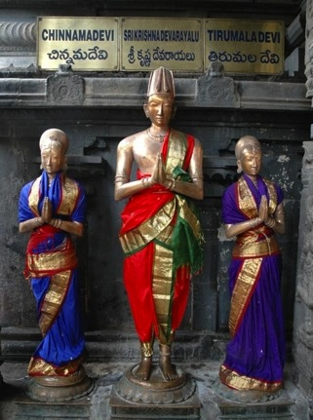
Krishnadevaraya and his queens Chennamadevi and Tirumaladevi
Tirupati
How might we read their bodies and gestures in relation to the variety of earlier and contemporary representations of divine, royal and working bodies? How might hero stones be read in relation other forms of portraiture?

Slide 4
The portrait bronzes of Krishnadevaraya and his wives present him as a king, a householder or grishasti and a devotee. The king commissioned them himself and had them installed in the Tirumala Tirupati temple dedicated to Vishnu as Venkateshwara.
The statues pose several questions:
What aesthetics govern the way these images are designed to represent the king and the queens?
What are the social roles that Krishnadevaraya and his queens embody in these statues? Krishnadevaraya is presented as the ideal king, householder, man and devotee in one image. How is this achieved? What are the precedents for this sleek group of images and how are they accessed and manipulated to imbue meaning in these figures?

Slide 5
Pallava to Nayaka
Aesthetics of the body
Tondaimandala Mamalla c 630-668 CE
Mahabalipuram, Adi Varaha cave,
c 630-668 CE
Tall and lithe, realistic and the emphasis on curves is not so pronounced

Slide 6
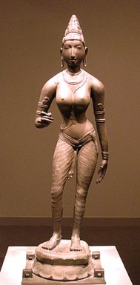
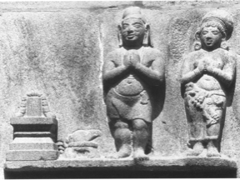
Royal Portraits
Top Left: Chola, Early 10th or 11th cen. CE
Top Right: Chola, Sembiyan Mahadevi, ca. 998 CE
Bottom: Portraits of Rajaraja I Chola and his queen Lokamahadevi, mahamandapa. Sivayuganatha temple, Tiruvisalur
Rajaraja Chola and his queen are depicted in diverging ways. He is shown in a gesture of worship with his hands joined and holding a gift or small baton-like object, perhaps as an offering. His body is only covered to the mid-thigh and stands in sambhanga. Lokamahadevi, his queen, is shown standing at leisure and the raised arm’s hand once must have held a flower or something else which is now lost. This makes me wonder if the two were originally a pair. On the other hand, it may be that queens were represented in this posterure as Lokamahadevi follows Sembiyan Mahadevi’s stance and gesture.
In contrast, the stone reliefs portray a shared attitude and gesture. The bodies are rotund and squat, fitting the height of the stone block.

Slide 7
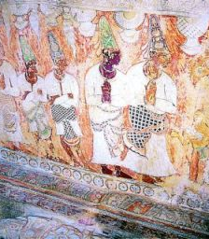
Vijayanagara Royal Figures
Left: Hampi, Relief Sculpture
Right: Lepakshi, Murals
A late Vijayanagara king is shown with a shorter and squatter profile. Perhaps the lower body covered to the ankles is difficult project to sculpt and show royal elegance of the body. Instead of slimness, royal presence emphasized by the towering kulayi.

Slide 8
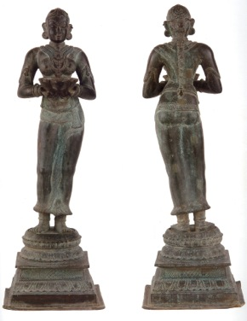
Male and Female Dipa Holders
Bronze, Vijayanagara
Figures are elegant and it is their grace that is emphasized. Their bodies sway in ways reminiscent of a flickering or dancing flame.

Slide 9
Embodied social roles
Ruler + Hero + Lover + Householder + Noble Lineage + Devotee

Slide 10
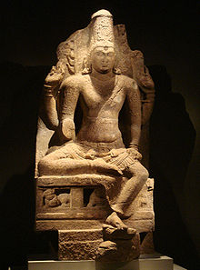
Enthroned King and Deity
Left: Pallava,
Mahabalipuram, Adi Varaha cave,
8th cen. CE
Right: Pandya, Vishnu 8-9th cen. CE
The parallels between kings and the divinities are made clearly by sculptors in Tamil country.

Slide 11
King as Connoisseur and Commander of Resources
Hampi, Reliefs from the Mahanavami Dibba, late 14th and early 15th cen. CE
King is watching wrestling and boxing matches, seated on a raised platform, with noblemen and/or officers to his side, perhaps a minister or a master to the wrestlers and male and female attendants with a yak-tail fan behind.
This early Vijayanagara images presents the king as a person who can enjoy a sporting tussle among worthy opponents. It also indicates that he has many such heroic figures in his command.

Slide 12
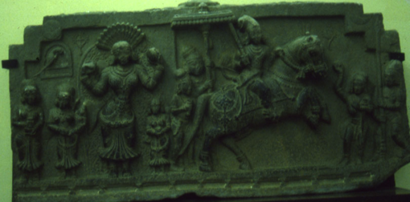
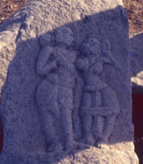
Noble Hero
Memorial Relief of a Royal Hero and his Wife
Hampi, Vijayanagara
Vijayanagara Archaeological Museum, Bangalore
The royal hero rides away into battle, sword drawn with a parasol hovering over him. He leaves behind a woman, most likely his wife, who holds a mirror in one hand and lemon in another. There are attendants as well, one of whom carries a small chlld. A domesticated parakeet, a symbol of love, hangs on a swing at the top. In the corners are a crescent moon and sun.
This is a portrait of a man about to set aside his role as a householder to become a warrior.
Lovers
Vijayanagara, Kannada Univ. Campus

Slide 13
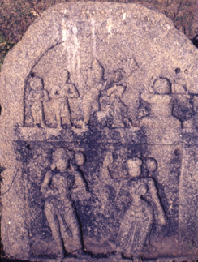
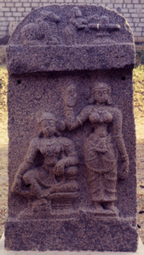
Sati Pillar and
Heroic Lovers
Sati and her Husband
in Sivaloka
Vijayanagara
Hampi, Vijayanagara
Sati and Husband
Hampi, Vijayanagara

Slide 14
Portraits of Gandaraditya Chola (center)and Uttama Chola( far left) worshipping the linga
Umamahesvara temple, Konerirajapuram
The kings are worship. Their parasol and yak-tail fan are inactive. Their full concentration is oriented to the linga and its worship by a priest or guru figure.
The emphasis is on a lineage of worshipping Shiva.

Slide 15
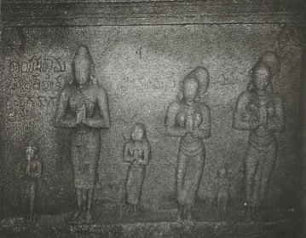
Portraits of Rajaraja I Chola and his queen Lokamahadevi
Mahamandapa, Sivayuganatha temple, Tiruvisalur
The figures are oriented both to the linga as well as the viewer. There are no visible signs of a royalness that has been set aside except the inscription which tells us who they are.
What is emphasized is their status as a couple, one who is joined in worshipping Shiva.
Rayasta Ramachandra Dikshita and Family
Hampi, Koti-tirtha
Ramachandra is show in worship with his two wives and three children. The age and/or status hierarchies between the various children and wives are visible in their varying heights.
But as a family, they are joined in worship of Vishnu.

Slide 16
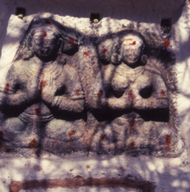
Memorial Stones of Devotee Couples
Hampi, Vijayanagara
Here are couples who are totally absorbed in their devotion to Shiva and are parallel in their steadfastness to Basava. They are sitting in samadhi.

Slide 17
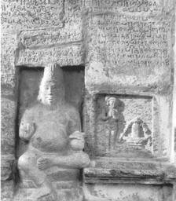
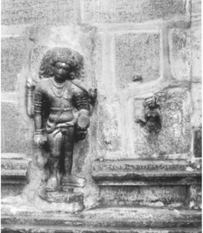
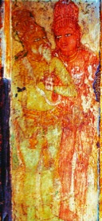
Devotees before Sivalinga
Left: Chola, Tiruvalanjuli, ca 800-899 CE
Right: Chola, 9th cen. CE?, Manavalavesvara temple, Tiruvilakkudi
Non-royal devotees performer worship to their god.
Yearners and an Accolyte
Left: Bhiksatana with two brahmin wives. Tiruvilakkudi, Chola, 9th cen. CE ?, Manavalesvara temple
Right: Guru and Follower, Thanjavur, Brihadishvara temple, early 11th cen. CE
The experience of devotion is intimacy.
The yearning upper caste housewives lose their clothing in their experience of Shiva as the wandering mendicant.
Rajaraja’s eyes are locked with his teacher’s. A true accolyte, he receives his knowledge by unwavering attention and devotion to his guru.

Slide 18
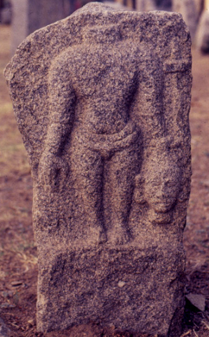
Fierce Annihilators
Left: Self-beheading devotee of Durga. Punjai, Chola, Naltunaisvara temple
Right: Self-beheaded devotee, Hampi, Vijayanagara.
This type of devotion is fearsome. In its extremeness is messy and does not accord comfortably with the idea of devotion as a social practice as it does not valorize reproduction.

Slide 19
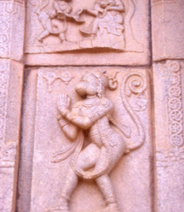
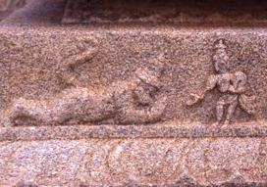
Passionate Bodies
Top Left: Total Surrender to Shiva, Punjai, Chola, Naltunaisvara temple
Top Right: Bhakta Hanuman, Hampi, Vijayanagara, Ramachandra temple, early 15th cen. CE
Bottom: Hanuman Does Sashtanga Namaskara to Rama, , Hampi, Vijayanagara, Ramachandra temple, early 15th cen. CE
Here total abnegation and surrender are carved on the body of the devotee. The top two figures sway and are on the verge of breaking the longitudinal axis that centers the body in itself. The bottom figure’s body is rendered on the same axis as the ground, thus lying, indeed becoming the path on which the object of devotion may tread.

Slide 20
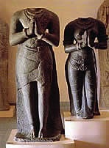
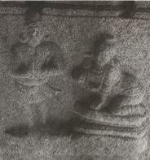
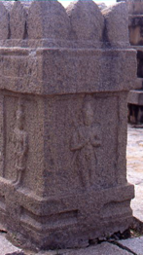
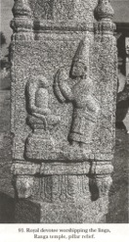
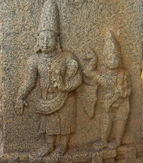
Vijayanagara Royal Portrait
Dignity

Slide 22
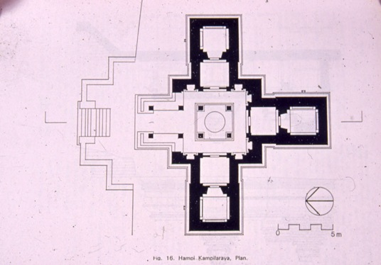
Comparative spatialization and embodiment of social relationships
Hampi, Hemakuta, Kampilaraya temple
Trikutachala plan and phamsana towers emphasize unity, lineage, dignity and relative equality of status.

Slide 23
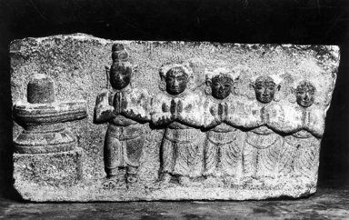
Devotees before Shivalinga
Thanjavur, ca 1600-1699 CE
Ideas and forms continue.
Nayaka Ruler
Garuda Mantapam, Srirangam, 17th century
Ideas and forms change even as they continue

Slide 25
<number>
Budget summary
Project Start : Feb 2011
Total Grant: Rs 12,00,000
First Installment : Rs 8,00,000
Expenditure to date: Rs 6,00,545
Balance : Rs 1,99,455 (as on 31st March, 2012)
Request to PAMC
Balance Rs 1,99,455 to be carried over
Second Installment of Rs 2,00, 000 may be released
Request Reallocation of Rs 50,000 from Travel to Software
Request Reallocation of Rs. 10,000 Travel to Contingencies
Notes:
<number>

